Slide 1
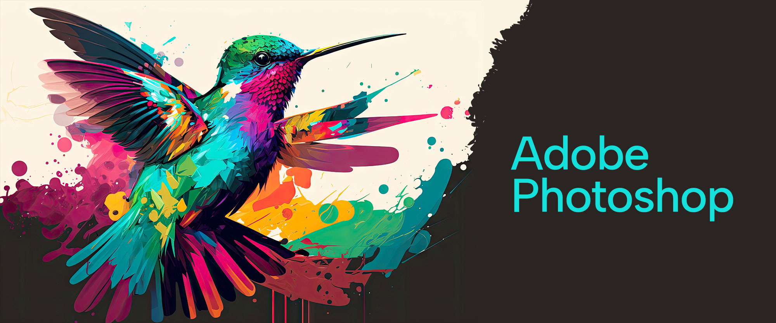

Slide 2
About today…
Exporting and Saving
(for Web and Print)

Slide 3
Exporting for Web
File Formats
JPEG
Ideal for photographs; balance between quality and file size
PNG
Suitable for images with transparency and sharper details
GIF
Good for simple graphics and animations with limited colors
Settings
Resolution
72 DPI (Dots Per Inch) is standard for web images
Quality
Adjust quality settings to optimize file size while maintaining visual fidelity
Image Size
Resize images to appropriate dimensions for web use
How to Export
Go to File > Export > Export As...
Choose format and adjust settings as needed

Slide 4
Exporting for Print
File Formats
TIFF
High-quality format with lossless compression; preferred for professional print
PDF
Versatile format supporting high-quality prints and complex documents
JPEG
Can be used for print, but ensure high resolution and quality settings
Settings
Resolution
300 DPI for high-quality prints
Color Mode
Use CMYK color mode for accurate color reproduction in print
Bleed and Margins
Include bleed areas and margins as required by print specifications
How to Export
Go to File > Save As... or File > Export > Export As...
Choose format and adjust settings for print quality

Slide 5
Understanding Resolution and Color Modes
Resolution
Web
72 DPI – suitable for online display
Print
300 DPI – necessary for crisp, high-quality prints
Color Modes
RGB (Red, Green, Blue)
Used for web and digital displays
CMYK (Cyan, Magenta, Yellow, Black)
Used for print to ensure color accuracy
How to Check
Go to Image > Image Size to adjust resolution
Go to Image > Mode to switch color modes

Slide 6
Optimizing Images for Web
Compression
Lossy Compression
Reduces file size with minor loss in quality (e.g., JPEG)
Lossless Compression
Preserves image quality while reducing file size (e.g., PNG)
Image Size
Resize
Adjust dimensions to fit web layout and improve loading times
Crop
Remove unnecessary parts to focus on the main content
How to Optimize
Use File > Export > Export As... and adjust quality and size settings

Slide 7
Preparing Images for Print
Bleed and Trim
Bleed
Extend artwork beyond the trim area to avoid white edges after cutting
Trim Line
Define the final size of the printed piece
Color Profiles
CMYK Profiles
Use profiles like U.S. Web Coated (SWOP) for accurate color printing
How to Prepare
Include bleed areas in your document setup
Use File > Save As... to save as TIFF or PDF with appropriate settings

Slide 8
Common Export Issues and Solutions
Issue
Color shifts
Solution
Ensure correct color mode (RGB for web, CMYK for print) and use proper color profiles
Issue
Loss of Quality
Solution
Use high resolution (300 DPI for print) and appropriate file formats (TIFF or PDF)
Issue
Incorrect Dimensions
Solution
Resize images correctly before exporting and check final dimensions

Slide 9
Practical Tips for Exporting
Preview Before Exporting
Always preview your image in the export dialog to check settings
Save Different Versions
Maintain separate files for web and print to preserve quality and settings
Check Specifications
Follow specific guidelines provided by printers or web platforms for best results
Regularly Save
Save work frequently to avoid losing progress and maintain different versions of your file

